Slide 1
Java Crypter
CSE1007 Project

Slide 2
Team members
Buddhsen Tripathi (19BCN7134)
Sahil Kumar Mishra (19BCN7044)
Priyanshi Sharma (19BCE7487)
Navya Katakam (18BCN7048)

Slide 3
Abstract
JavaCrypter is a program written in java which has a basic purpose of encryption/decryption of files with Caesar cipher.
Text Documents, PDF, Images and also videos are supported.
The GUI interface is implemented using Java Swing.

Slide 4
Objective
Convert/Hide the plain data/understandable data to other form to achieve data protection in a simplest manner.

Slide 5
Introduction
Encryption is one of the best tools at protecting data when it comes to
computer security. There are many forms of encryption as well. One of
the basic yet effective form that I encountered recently in my work is
Caesar Cipher Encryption.
what exactly is Caesar Cipher Encryption?

Slide 6
Caesar cipher is a type of substitution cipher in which each letter in
the plaintext is replaced by a letter some fixed number of positions
down the alphabet. For example, with a left shift of 3, D would be
replaced by A, E would become B, and so on. The method is named
after Julius Caesar, who used it in his private correspondence.
In this project we will start with the discussion about the Caesar Cipher
then move forward with the environment used for the implementation
and with procedure been Implemented to achieve data security.

Slide 7
Problem Statement
Caesar’s cipher shifts each letter by a number of letters. If the shift
takes you past the end of the alphabet, just rotate back to the front of
the alphabet. In the case of a rotation by 3, w, x, y and z would map to
z, a, b and c.

Slide 8
Implementation
The Programming language used is Java. The Java Library used to
implement GUI interface is swing.
The Implementation contains 5 files:
App.java (Executable/Driver class)
CipherTools.java (Process of Encryption/Decryption)
FileTools.java (utility methods for writing and reading binary data)
Mode.java (enum function modes of the program)
MyActionListener.java (Implement ActionListener)

Slide 9
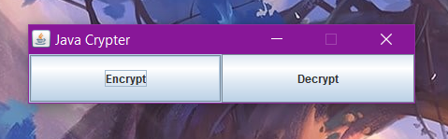
When we run the program, It’ll display basic UI which contains two option and user has to select one among them.
Suppose you click Encrypt option, the flow will be redirected to ActionListener and further progresses.

Slide 10
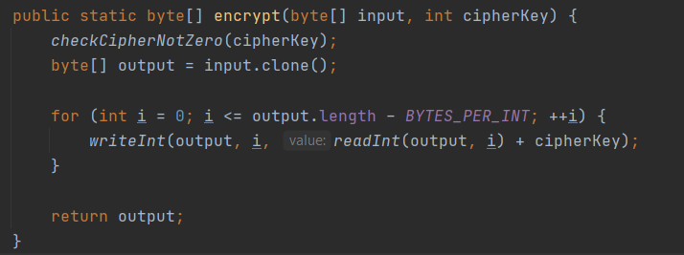
The ActionListener invokes the methods for selection and Encryption of the file.
The encryption method checks for any empty key and proceeds further.

Slide 11
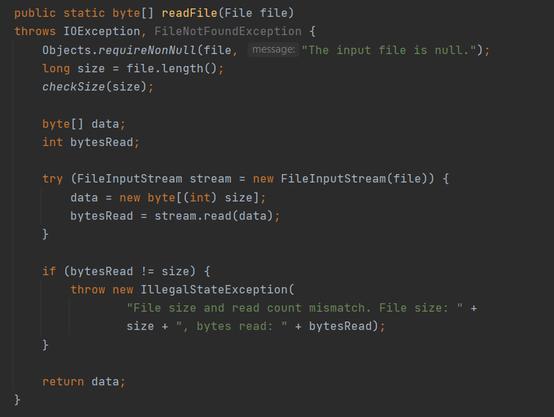
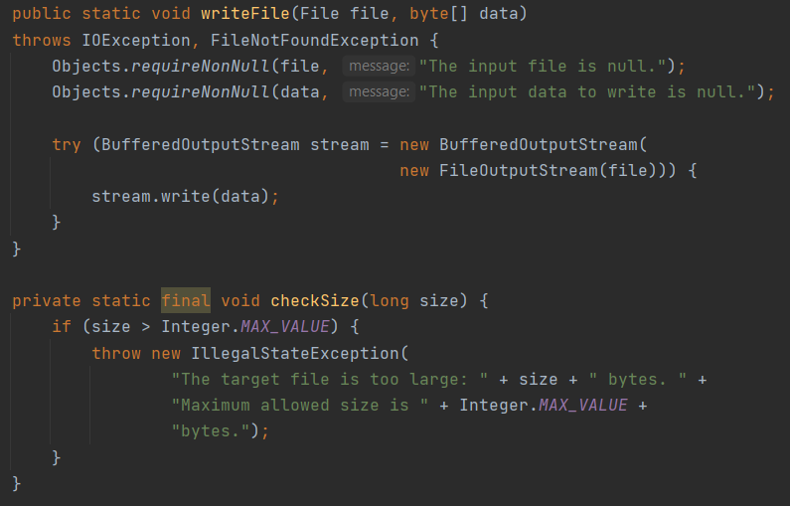
The programs reads the file inputs and writes the changes according to the key provided by the user as the name suggests it creates a ciphertext and it’s not understandable.

Slide 12
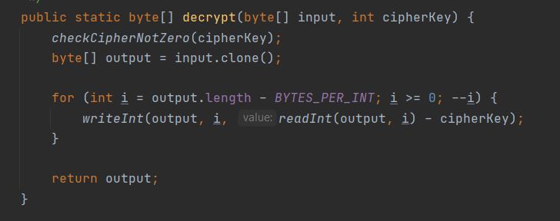
Once Encrypted we have achieved half of the objective.
The Decryption process goes the same way, the selection of file, entering the secret key and the programs read and makes changes to retrieve the plain data from ciphertext.

Slide 13
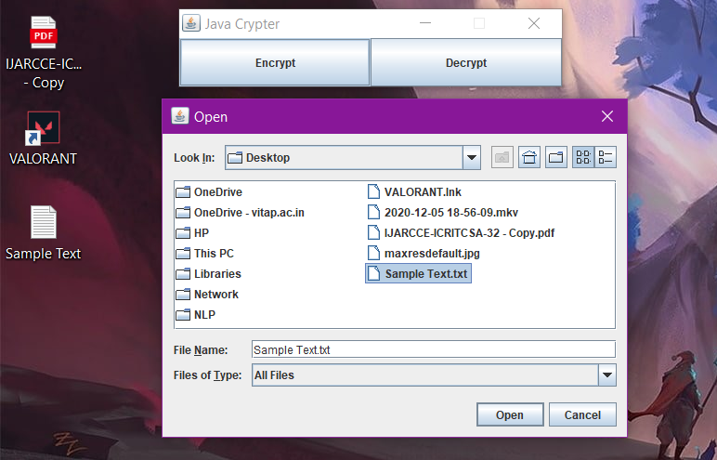
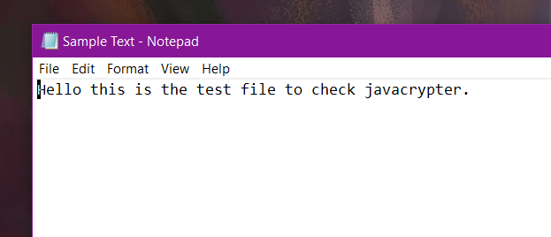
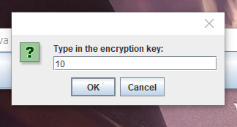
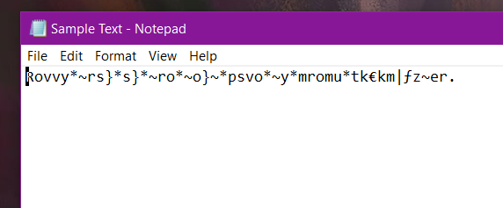
Results - Encryption

Slide 14
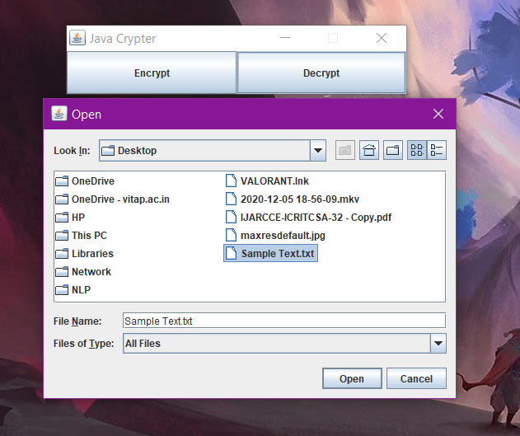
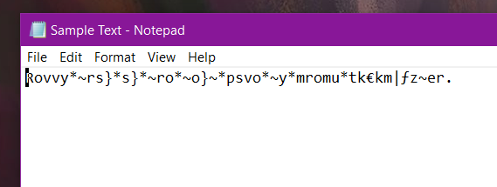
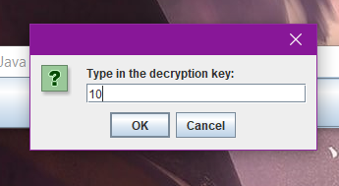
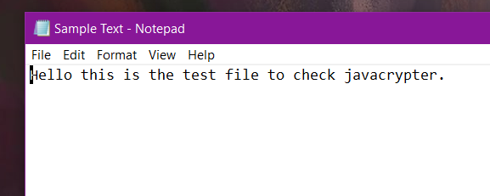
Results - Decryption

Slide 15
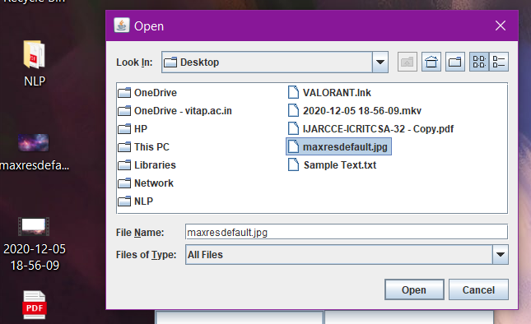
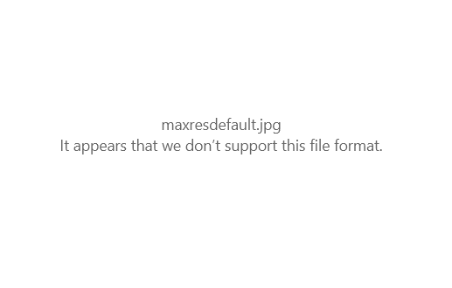
Observation
The program also works for Images/videos as the program makes bitwise changes into the file, hence once encrypted with this program, the image/video won’t open and once we decrypt it’ll run/display again.

Slide 16
Conclusion
The program achieves it’s objectives yet the project seems simple.
The project does maintain data security, but Caesar cipher is not effective enough in today’s era and someone with knowledge of simple cryptography techniques may exploit the ciphertext info.
The project can be further built into bringing more complications and advanced algorithms to make data even more secure but I’m happy to use the knowledge I’ve to create something to maintain data protection at local level.

